Slide 1
Player Scheduling System
Tonny Boesenbaek & John O’Keefe

Slide 2
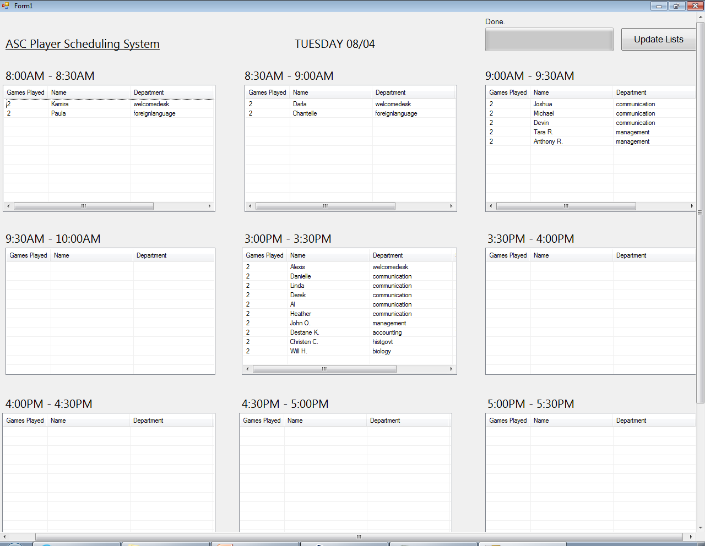

Slide 3
ASC Player Scheduling System
Get a list of employees from each department…
That are at work today,
That are at work between:
8:00AM - 8:30AM … 9:30AM – 10:00AM
3:00PM – 3:30PM … 6:30PM – 7:00PM.
Order list ascending by number of times 'picked'.
Subtract min. number of employees needed on duty from list.
Remove person from list if he/she has already had a recess today.
Remove person from list if he/she has already had 7 recesses this month.
If only one person is able to take a recess in a half-hour time slot, that person will be rescheduled for another timeslot.
Add '1' to number of times 'picked‘.
Display person in the graphical user interface.

Slide 4
Additional Features
Handles people working in multiple departments.
Handles lunch breaks.
Handles half-hourly changing minimum number of staff needed on duty.

Slide 5
Upcoming Features for Fall Semester
?
Give me your ideas!

